Slide 1

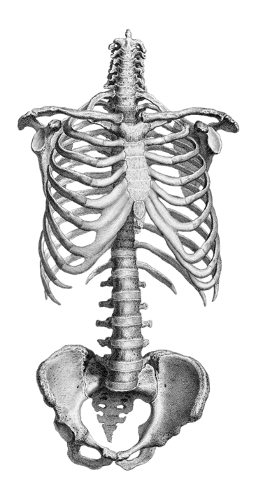

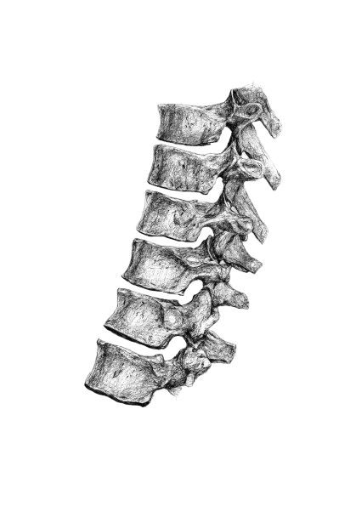
MARROW
An Integrated Multi-Label Deep Learning Framework for Anatomical and Pathological Classification of Musculoskeletal Radiographs

